Slide 1
An Introduction to
Microsoft Azure
By P.S.R.Patnaik
Microsoft Specialist: Architecting Microsoft Azure Solutions
Microsoft, License F312-3640,
AWS Certified Solutions Architect - Associate
Amazon Web Services, License 639BWPV1JFRE11CR

Slide 2
Workshop
Overview
Module 1: Overview of the Microsoft Azure Platform
Module 2: Building Application Infrastructure in Azure
Module 3: Hosting Web Applications on the Azure Platform
Module 4: Storing SQL Data in Azure
Module 5: Designing a Communication Strategy by Using Queues and Service Bus

Slide 3
Module 1:
Overview of the Microsoft Azure Platform

Slide 4
Module 1 Overview
Microsoft Azure provides a collection of services that you can use as building blocks for your cloud applications.
Lesson 1, Azure Services, provides a recap of the services that you might have worked with when using the Microsoft Azure platform in the past.
Lesson 2, Classic Portals, describes the two current portals that are available for managing Azure subscriptions and services.
Lesson 3, Lab Overview, provides a walkthrough of the lab application that you will be working on throughout the course.
Objectives
After completing this module, you will be able to:
Describe some of the common Azure services.
Describe the differences between the Microsoft Azure, Classic Portal and the Azure Portal.

Slide 5
Module 1 Continued. . .
Azure Services > Overview
This module describes some of the common services and features, used by many entry-level Azure developers and IT professionals, which are available in Azure.
Objectives
After completing this module, you will be able to describe the following Azure services:
Websites
Virtual Machines
Cloud Services
Storage
SQL Database
Virtual Network

Slide 6
Module 1 Continued. . .
Azure Services > Services Overview
The Azure platform is a collection of services that allows you to host existing workloads, use managed services instead of a workload, and create greenfield workloads. In the majority of projects, you might use only a subset of the available services in the Azure platform. It is very typical to find varying levels of experience amongst your peers. In this course, you will learn about the most common services that you can use in new development projects that will be hosted on the Azure platform.

Slide 7
Module 1 Continued. . .
Azure Services > Services Overview
The following are the common Azure services:
Physical Infrastructure Alternatives
Communication Infrastructure
Data Streaming and Storage
Web Hosting
Mobile Connectivity

Slide 8
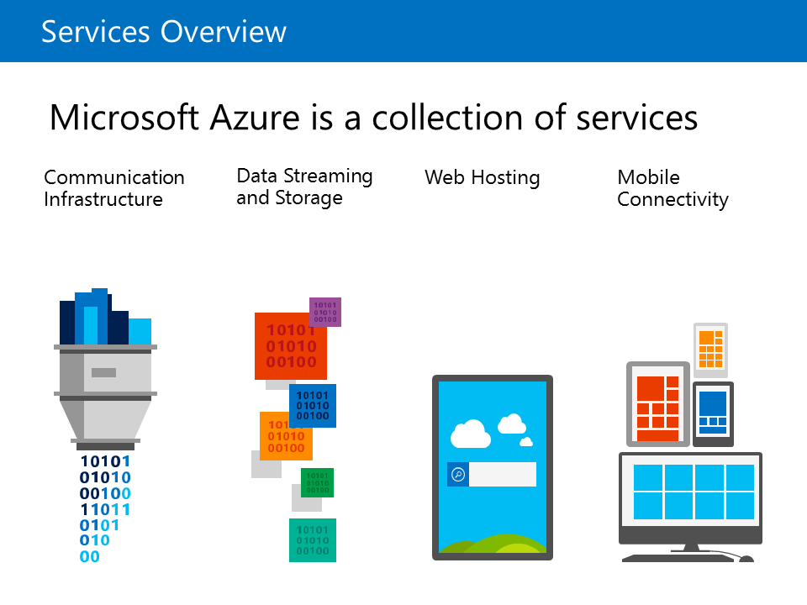
Module 1 Continued. . .
Azure Services > Services Overview
In your development projects or workloads, you can choose to use as many available services as needed to meet your requirements.
The following are the common Azure services:

Slide 9
Module 1 Continued. . .
Azure Services > Overview of the Azure Platform
VIDEO

Slide 10
Module 1 Continued. . .
Azure Services > Web Apps
Web Apps
Web Apps provides platform for your web applications with many features to reduce the friction of deployment. A high degree of compatibility with Internet Information Server (IIS) websites allows you to configure your web applications by using familiar IIS configuration settings. Because the platform is highly managed, you can scale up your web applications automatically with load balancing, which is also configured automatically.

Slide 11
Module 1 Continued. . .
Azure Services > Web Apps
Supported Frameworks
The Web Apps service allows you to use ASP.NET, Java, PHP, Node.js, or Python as an application framework for your web applications out of the box. You can also use popular CMS solutions with custom templates and markup languages, such as Drupal, Joomla, DotNetNuke, and Umbraco, with the platform for your web solutions.

Slide 12
Module 1 Continued. . .
Azure Services > Web Apps
Deployment
Integrated Development Environments (IDEs), such as Microsoft Visual Studio, can deploy web applications to Web Apps by using either the FTP or the Web Deploy protocol. Web Deploy provides an encapsulated package format that you can use to migrate IIS web applications or websites between environments or from a development IDE to an IIS instance. Application developers can use the packaged format to specify connection strings or application settings that are required during installation.

Slide 13
Module 1 Continued. . .
Azure Services > Web Apps
No Ops
The Web Apps environment is fully managed, which allows you to have a scalable web hosting platform that is resilient and highly available without having to specifically manage each website instance at a low level. This also allows you to scale up your web application by simply configuring a set of values.

Slide 14
Module 1 Continued. . .
Azure Services > Virtual Machines
Virtual Machines
Virtual Machines provides compute on demand for your application workloads with a high degree of compatibility with existing virtualization workloads. By using the standardized .vhd format from Hyper-V disks, infrastructure administrators can easily on ramp existing Hyper-V workloads to Azure.

Slide 15
Module 1 Continued. . .
Azure Services > Virtual Machines
Workloads
Virtual Machines supports a list of common Microsoft application workloads. Software platforms such as Microsoft SharePoint, Microsoft SQL Server, Dynamics GP, and BizTalk Server are fully supported using the infrastructure hosted in Azure. By connecting Virtual Machines to your on-premises network, you can enable disaster-recovery and high-availability solutions such as SQL Server AlwaysOn.

Slide 16
Module 1 Continued. . .
Azure Services > Virtual Machines
Templates
You can create the majority of supported workloads in Azure by using pre-built templates on the portal. Microsoft and third-party images are available for both Linux and Microsoft-supported application workloads. Standard operating system images for Windows and Linux are also available for new projects. VM Depot is also available for community-provided Linux images.

Slide 17
Module 1 Continued. . .
Azure Services > Virtual Machines
Choice in Sizing
You can configure virtual machines with a variety of options for CPU, memory, and IOPS, commonly referred to as VM sizes. The Basic and Standard sizes are available for the most common application workloads. Larger standard sizes are also available for memory intensive workloads. D-size virtual machines are available with a faster processor and a local solid-state drive (SSD). G-size virtual machines are available for workloads that require massive compute or memory resources.

Slide 18
Module 1 Continued. . .
Azure Services > Storage
Storage
Storage is a managed service that allows you to store data that can be used throughout your cloud applications. The data that is stored can include loosely structured entities, queue messages, and various files. You can access this data by using client libraries, URLs, or the REST API. You can store and manage files by using files shares.

Slide 19
Module 1 Continued. . .
Azure Services > Storage
Blobs
Blobs are managed files that can be persisted and accessed by using URLs, the REST API, or a client library. You can use containers to logically group blobs. Blobs are used throughout service instances, such as Virtual Machines that uses blobs to store virtual hard disks.

Slide 20
Module 1 Continued. . .
Azure Services > Storage
Queues
The Queue service provides a simple managed interface to push messages into a queue and consume the same messages. Messages are stored as serialized strings. They can be stored or retrieved in a First-In First-Out manner by using logical queue actions, such as enqueue, dequeue, and peek.

Slide 21
Module 1 Continued. . .
Azure Services > Storage
Tables
The Table service is a NoSQL store that allows you to store loosely structured sets of entities that can be persisted en-masse and retrieved with exception efficiency. By implementing common sharding concepts, such as partitions and hash indexes, you can use tables to store large quantities of data for your application.

Slide 22
Module 1 Continued. . .
Azure Services > Storage
Files
The Azure Files service provides an SMB 2.1 protocol file share that you can use when you migrate existing application workloads from on-premises to Azure. The files that are persisted by using this technology can also be accessed by using the REST API or client libraries.

Slide 23
Module 1 Continued. . .
Azure Services > SQL Database
SQL Database
SQL Database is a managed Database-as-a-Service platform that you can use to host your SQL objects. It is highly compatible with existing data tools and therefore it provides you with similar management experience that you will have with SQL Server Standalone.

Slide 24
Module 1 Continued. . .
Azure Services > SQL Database
Compatibility
Many SQL features and objects can be used with SQL Database. SQL Server 2014 provides tooling that you can use to analyze and migrate your databases from an on-premises server to Azure. For earlier versions of SQL, tools such as the SQL Azure Migration Wizard and the Azure Websites Migration Assistant are available for assessing your existing database and performing the actual migration.

Slide 25
Module 1 Continued. . .
Azure Services > SQL Database
Data Tools
You can use many existing data tools such as SQL Server Data Tools for Microsoft Visual Studio and SQL Server Management Studio with SQL Database. Other tools and application frameworks can use connection strings to connect to the databases that are hosted in Azure. You can provide the connection strings for SQL Database instances directly on either portal. SQL Database also provides a custom portal for managing databases.

Slide 26
Module 1 Continued. . .
Azure Services > SQL Database
Scalability
Elastic Scale can be used with a SQL Database instance to automatically create and manage defined partitions for applications with dynamic or large database workloads. Applications that can benefit from this feature range from large data stores to multitenant Software-as-a-Service (SaaS) services.

Slide 27
Module 1 Continued. . .
Azure Services > Virtual Networks
Virtual Networks
Virtual Networks are a security boundary that you can create so that service instances can communicate with each other privately. Virtual networks support instances of the Websites, Cloud Services, and Virtual Machines services. Through the various connectivity options, virtual networks can be connected to each other or to an existing on-premises machine or network.

Slide 28
Module 1 Continued. . .
Azure Services > Virtual Networks
Site Connectivity
You can connect virtual networks with each other or with an existing on-premises network by using the Internet Protocol Security (IPSec) protocol. This allows a secure link between multiple networks and various hybrid cloud scenarios. VPN Devices that support this connectivity can be determined by using a list of known supported VPN devices or a list of features that are required to be supported by a device that will be used with a Site-to-Site connection.

Slide 29
Module 1 Continued. . .
Azure Services > Virtual Networks
Direct Connectivity
The Secure Sockets Tunneling Protocol (SSTP) can also be used to allow an individual device or a computer to directly connect to a virtual network by using a Point-to-Site virtual private network (VPN) connection. This is useful in scenarios where an on-premises location does not have the hardware that supports IPSec or a network needs to be used by multiple remote workers.

Slide 30
Module 1 Continued. . .
Azure Services > Virtual Networks
Domain Name Service (DNS)
Azure automatically provides a DNS service for virtual machines and services in a virtual network. You can optionally provide an IP address for your own DNS server that is either hosted in Azure or connected by using one of the previously mentioned connections.

Slide 31
Module 1 Continued. . .
Azure Services > Azure from the Developer’s Perspective
VIDEO

Slide 32
Module 1 Continued. . .
Azure Portals > Overview
Many iterations of Azure services and the web applications to manage those services are currently available.
This module describes the last two iterations of the Classic Portal, which you can use for configuring instances of Azure services. This module also provide a walkthrough of how to switch between the two Azure Portals when the functionality you require is not available in one of the portals.
in Azure.
Objectives
After completing this module, you will be able to :
Describe the current Azure Portal.
Describe the Classic Portal.
Switch between the different portals.

Slide 33
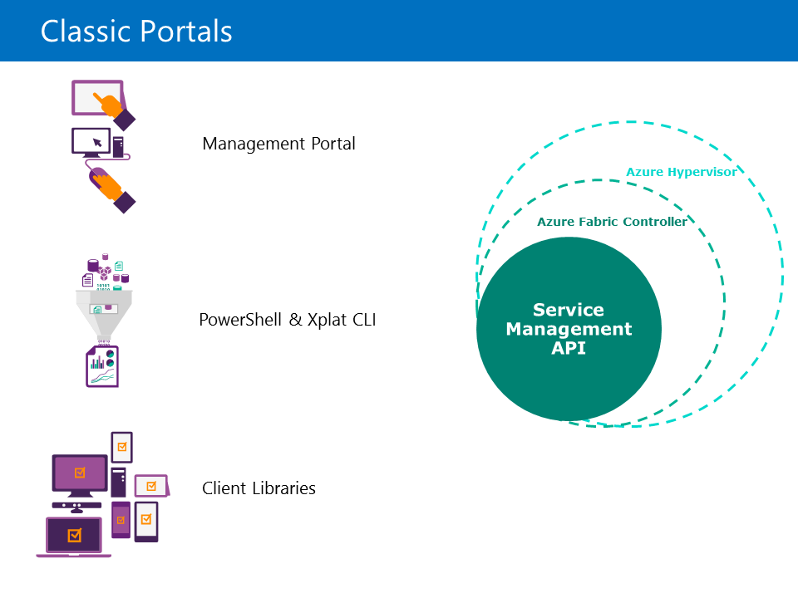
Module 1 Continued. . .
Azure Portals > Overview
Azure as a platform can host your applications and workloads in the cloud. The Service Management REST API that receives requests to create, change, or configure services and passes the requests to the Microsoft Azure Fabric Controller.

Slide 34
Module 1 Continued. . .
Azure Portals > Overview
The Classic Portal is one of many different interfaces that you can use to interact with the Azure platform. There are currently two primary versions of the Classic Portal. The first is the current portal that will be referred to as the Classic Portal in this course. This portal uses an interface where services are shown on the left and the service instance pages use tabs to organize data. The latest portal is referred to as the Portal in this course. This portal uses a list of horizontal blades to organize data and provide a symmetric drill-down experience.

Slide 35
Module 1 Continued. . .
Azure Portals > Accessing the Azure Portals
VIDEO

Slide 36
Module 1 Continued. . .
Azure Portals > The Classic Portal
The Classic Portal
It replaces a Microsoft Silverlight portal and uses HTML5 and JavaScript for a rich, dynamic, and fast user experience. In the Classic Portal, services are listed on the navigation bar that is on the left side of the portal. When you select a service, a landing page for the service displays with a list of service instances. Service instances themselves can contain multiple tabs that display data such as configuration options, metric monitoring, and an overview dashboard.

Slide 37
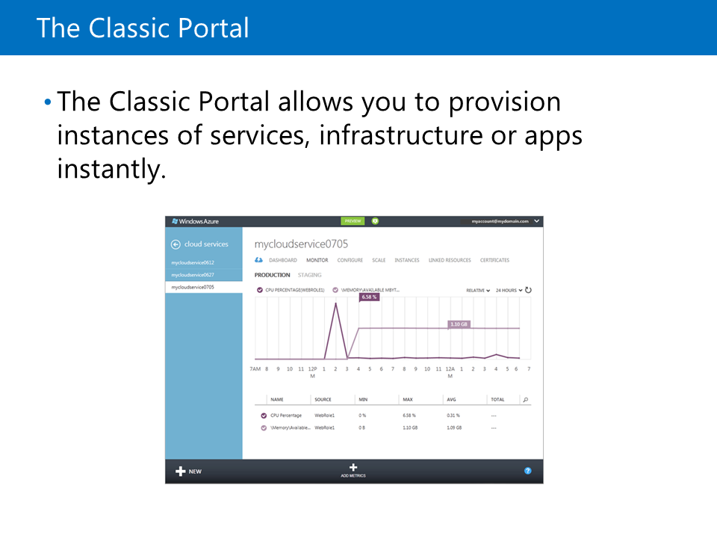
Module 1 Continued. . .
Azure Portals > The Classic Portal
The Classic Portal was released at TechEd 2012.

Slide 38
Module 1 Continued. . .
Azure Portals > The Classic Portal
Service Construction
In the Classic Portal, a black bar is available at the bottom of the screen that you can use to create new instances of a service. If you click the +New button without selecting a specific service on the blue navigation bar, a list of all the available services displays. You can select any service from this list to create an instance of it. If you select a service on the navigation bar and then click +New, a dialog box displays, where the option to create a new instance of the service is automatically selected.

Slide 39
Module 1 Continued. . .
Azure Portals > The Classic Portal
Service Construction . . .
You can then use the Quick Create option to create the service instance by specifying only the required parameters. Optionally, you can use the Custom Create option to specify all the service parameters by using a wizard.
The +New dialog box allows you to quickly create new service instances.

Slide 40
Module 1 Continued. . .
Azure Portals > The Classic Portal
Tabs
When you select a service instance, a list of tabs display. You can use these tabs to view data and configuration options for the service. The first tab is typically a quickstart tab that displays the hyperlinks to the tutorials and suggestions for getting started with the service. There is also a dashboard tab that displays the current status of the service. The other tabs are used to categorize configuration options that are available for the service instance.

Slide 41
Module 1 Continued. . .
Azure Portals > The Classic Portal
Account Portal
An account portal is available to view information about your current subscriptions. In this portal, you can manage your subscription by modifying its name, the service administrator, and the billing data. Many of these features are already included in the Portal.

Slide 42
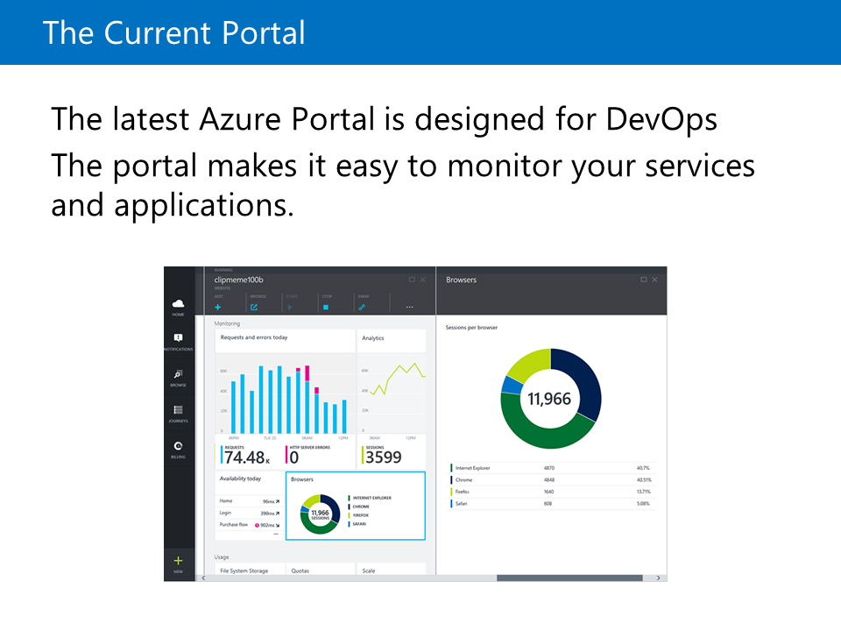
Module 1 Continued. . .
Azure Portals > The Current Portal
The latest version of the portal was released at //build 2014. The focus of this new portal is to display more metadata about each service instance and group the services logically for monitoring and billing. Additional features are released for the new portal on a weekly basis and this rapid cadence.

Slide 43
Module 1 Continued. . .
Azure Portals > The Current Portal
Blades
When you view the settings for a service instance or take an action, the details are displayed in a vertical dialog box known as a blade. You can stack these blades horizontally so that you can view the details of a service (or an action) and some of the follow-up actions without having to scroll horizontally.

Slide 44
Module 1 Continued. . .
Azure Portals > The Current Portal
Blades . . .
You can close a blade by clicking the close (X) button at the top-right corner. You can click the pin icon at the top-right corner to pin the blade to your Dashboard for future access. You can minimize the blades to place them on the left side of the screen and maximize them to fill the entire width of your screen. You can hide the labs on the top command bar to create more screen space for your tiles. Finally, you can customize the order and layout of the tiles in most blades.

Slide 45
Module 1 Continued. . .
Azure Portals > The Current Portal
Journeys
Journeys are a collection of sequential blades that you can use to create or modify a service. For example, to create a Website, you can go to the gallery blade, and then view the website gallery options blade. After you select a specific website template, a blade describing the template displays. If you click Create, another blade displays with basic options for the new Website.

Slide 46
Module 1 Continued. . .
Azure Portals > The Current Portal
Journeys . . .
Many of these advanced options might display a subsequent blade. These blades that are displayed in a horizontal sequence are known as a journey. In a journey if you try to close a blade, which is to the left of another blade, without saving the changes, a message displays informing you about the loss in progress. Journeys are sometimes broken down in to Journey Parts, but this is not currently visualized in the user interface.

Slide 47
Module 1 Continued. . .
Azure Portals > The Current Portal
Dashboard
The Dashboard is the first screen you see when you log on to the Portal. It is a collection of tiles that you can reorganize, resize, and remove. As you view the blades in your subscription, you can pin them to the Dashboard so that you can return to them at a later point in time. You can also resize the tiles to emphasize specific data

Slide 48
Module 1 Continued. . .
Azure Portals > The Current Portal
Dashboard . . .
Many tiles show different metrics and icons depending on their size. For example, the Service health tile displays a world map in the largest size, but in the smallest size it displays only a count of the services that are healthy. By default, when you create a new instance of a service, the option to add a tile to the Dashboard for that instance is selected.

Slide 49
Module 1 Continued. . .
Azure Portals > The Current Portal
Billing
Previously, you had to switch from the Classic Portal to the Account Portal to view the billing data for your services. In the Portal, you can view the up-to-date billing data for your entire subscription in the form of charts and infographics. The charts and infographics will help you understand the impact of individual service instances and service types. Charts, such as the Burn rate, also help you forecast the charges to your account in each billing period.

Slide 50
Module 1 Continued. . .
Azure Portals > The Current Portal
Resource Groups
Resource groups represent a new way of logically grouping your service instances. Service instances are known as resources and a collection of resources can exist in a resource group. By using resource groups, you can view the metrics and billing data for a specific group in your subscription. Resource groups also allow your service instances to share a common lifecycle, where you can create a group with multiple resources defined or remove a group.

Slide 51
Module 1 Continued. . .
Lab: Exploring the Azure Portals
Lab: Exploring the Azure Portal

